Slide 1
Lewis & Clark
The Fantastic Journey

Slide 2
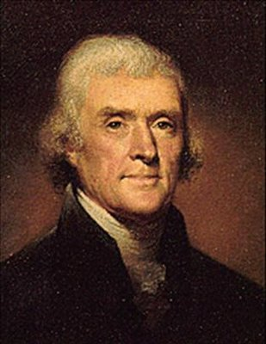
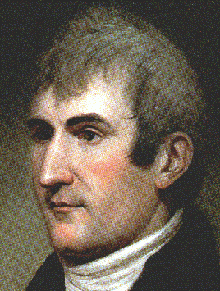
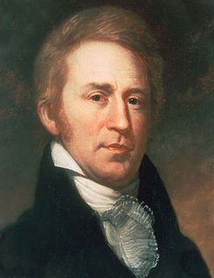
The Proposal
After the Louisiana Purchase, Lewis and Clark set out on a military expedition with a small group of men to create a report for President Jefferson to include the following:
Map a new route to the Pacific
Make contact with Native Americans
Obtain specimens for further study
Keep a full record of activities during the Expedition

Slide 3
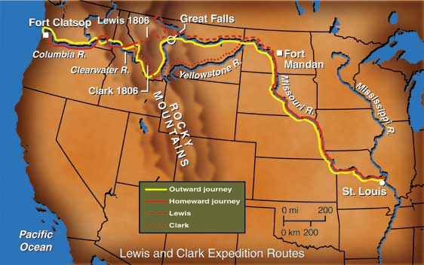
How far west did Lewis and Clark travel before heading north?
How far north did the expedition travel to Ft. Mandan?
Notes:
Effect used for line: Insert draw line, use the free form. Draw the line from beginning to end. Choose color for line and any other styles. I used a yellow line with a blue glow. I also specified the beginning of the line to be a circle and the end to be an arrow. I then chose the animation “Wipe” for the entrance and slowed the speed down to very slow.. When played, the animation begins on click and appears as a line traveling.
How many miles total from St. Louis to Fort Mandan?

Slide 4
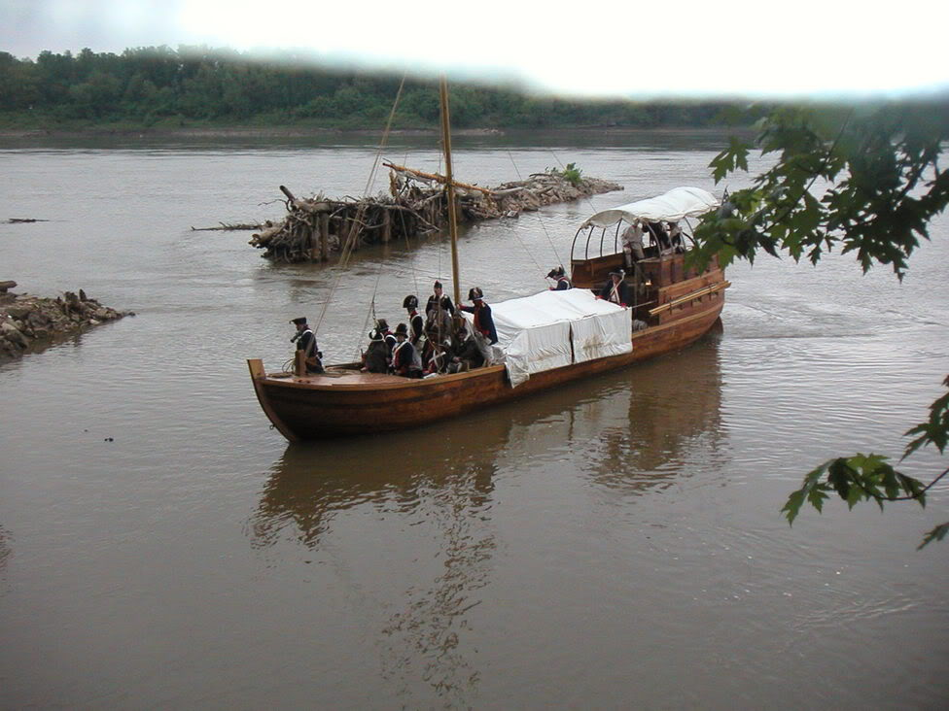
Traveling the Missouri River

Slide 5
Click here to explore sites along the Missouri north to Ft. Mandan:
http://lewisandclarktrail.com/eventsstate/discovery.htm

Slide 6
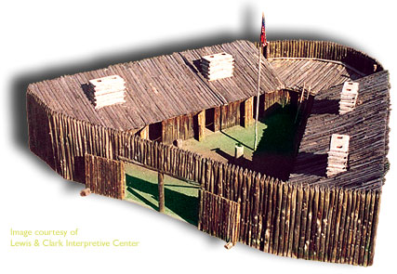
Fort Mandan- Click the Fort for a tour of the inside.

Slide 7
Journey with the Expedition Team!
Use the following web-link to join the expedition team.
This link will allow you to be a member of the expedition team. You will help make decisions on the expedition. See what happens along the way!
http://www.nationalgeographic.com/west/main.html
Or
http://www.pbs.org/lewisandclark/into/index.html

Slide 8
Your Journey
From the materials found in this presentation and
Using the resources available on the last slide,
You are to create a presentation report to President Jefferson of your findings on the expedition. Did Lewis and Clark complete the tasks that President Jefferson expect? Support you answers.
Use the template pages to follow to include in your presentation. Template pages are printed on “Expedition Document.”
Map a new route to the Pacific
Make contact with Native Americans
Obtain specimens for further study
Keep a full record of activities during the Expedition

Slide 9
Corps of Discovery
Notes to the President
Submitted by
Your name

Slide 10
Maps
Notes:
On this next slide, insert a map picture as done by Lewis and Clark. Include information describing the mileage, areas of difficulty due to climate, terrain, etc. What is “dead reckoning?” Add additional slides for information and images. You might want to include tools for mapping. Did Lewis and Clark find a new route to the Pacific? How will this be an advantage for United States? You might need to add one or two additional slides.

Slide 11
Relations with Indians
Arikaras
Assiniboins
Blackfeet
Chinooks
Hidatsas
Mandans
Missouris
Nez Perces
Otos
Shoshones
Teton Sioux
Tillamooks
Walla Wallas
Yankton Sioux
http://www.pbs.org/lewisandclark/native/index.html
Notes:
Using the web-site listed and one other webite resource of your choice,Choose one of the Indian Nations and discuss the where Lewis and Clark met them and how they related with them. What were the challenges? What did they trade? Did Lewis and Clark establish good political relationships with the Indians you are researching? Include at least on image that supports your research. You may need to create 2 or more additional slides for this section.

Slide 12
Specimens from the Journey
http://lewisandclarktrail.com/nativeplants.htm
Notes:
Lewis and Clark documented many of the plants and animals they came across. Using the above weblink and one other resource of your choice, describe one of the plant specimens collected. Where was this specimen founc? What important value does it have? Include one photo of the plant you chose. Did Lewis and Clark bring back a sufficient report to the President?

Slide 13
Record of the Journey
http://www.lewisandclarktrail.com/diary.htm
Notes:
Choosing one of the areas on your map, describe what events took place. Use the above web-link to determine the time frame of your adventure. Choose 5 journal entries written by Lewis & Clark. Create a slide that shows the date, place, description and/or and any other pertinent info that took place.

Slide 14
Resources
"Lewis and Clark." . 2001. National Geographic. 4/1/2004
<http://www.nationalgeographic.com/xpeditions/activities/01/lewis_map_4.html>.
Neiman, David. Lewis and Clark Expedition. 2004. 4/1/2004
<http://www.pbs.org/lewisandclark/inside/idx_equ.html>.
Lewis and Clark Corps of Discovery 6 /27 2011
<://www.history.army.mil/LC/Explore/Fort_Mandan/gallery.htm>
National Park Service's National Register of Historic Places
<http://www.nps.gov/nr/travel/lewisandclark/index.htm 7/29/2011>
The Lewis and Clark Trail National Park Service, November 5, 2011
<http://www.lewisandclarktrail.com/>
Notes:
Add any additional resources you used under the ones provided on this slide.

