Slide 1
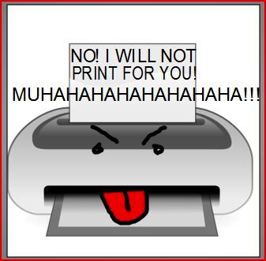
Get Control of Your Printer!
http://www.bkconamore.com/2011/08/friday-fun-finds-1.html
Check Power & Connections | Check Drivers & Settings | Check Paper Cartridges | Check Ink Status | Find More Resources
No power?
Can’t find printer?
Paper jam?
Poor print quality?
More questions?

Slide 2
Check all Connections
Power | USB | Parallel Port | Network Settings | Home Menu

Slide 3
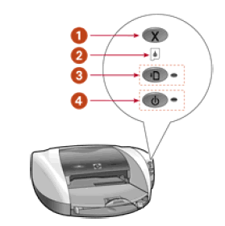
Power ?
First check to make sure your printer is turned on.
If the light will not turn on, check the power cords into the printer and the power source.
If the light is blinking, the printer is showing a status error.
Some printers have specific light signals to determine the problem:
1 - Cancel button
2 - Print Cartridge status light
3 - Resume light
4 - Power light
Image "Cite"
Still not turning on? Check your cable or network connections.

Slide 4
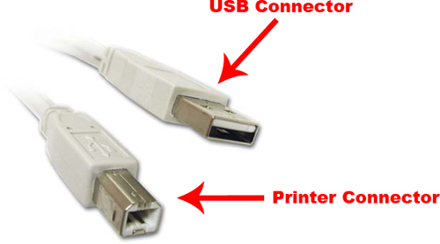
USB Ports
If you are connecting with a USB, connect the printer directly to the computer’s
USB port. If you are using multiple hubs, connect the printer to the first tier hub.
http://www.oxstyle.com/2012/07/usb-to-printer-cable.html
Return to the home screen and choose the next option to check or choose other options for connections

Slide 5
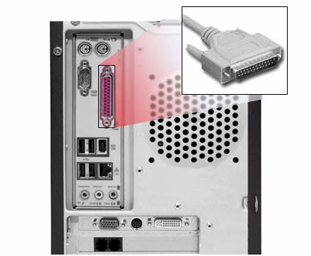
Parallel Ports
If your printer uses a parallel port, check to make sure connections are secure.
Return to the home screen and choose the next option to check or choose other options for connections

Slide 6
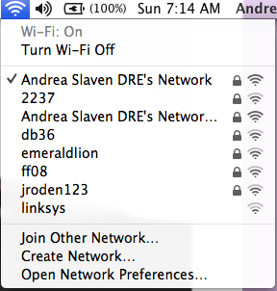
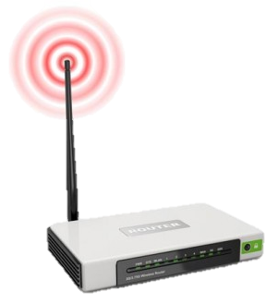
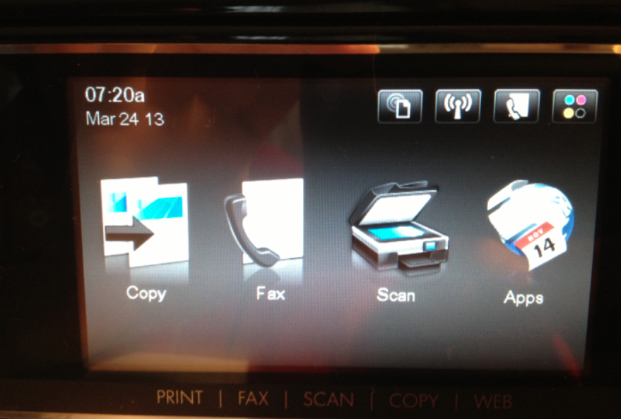
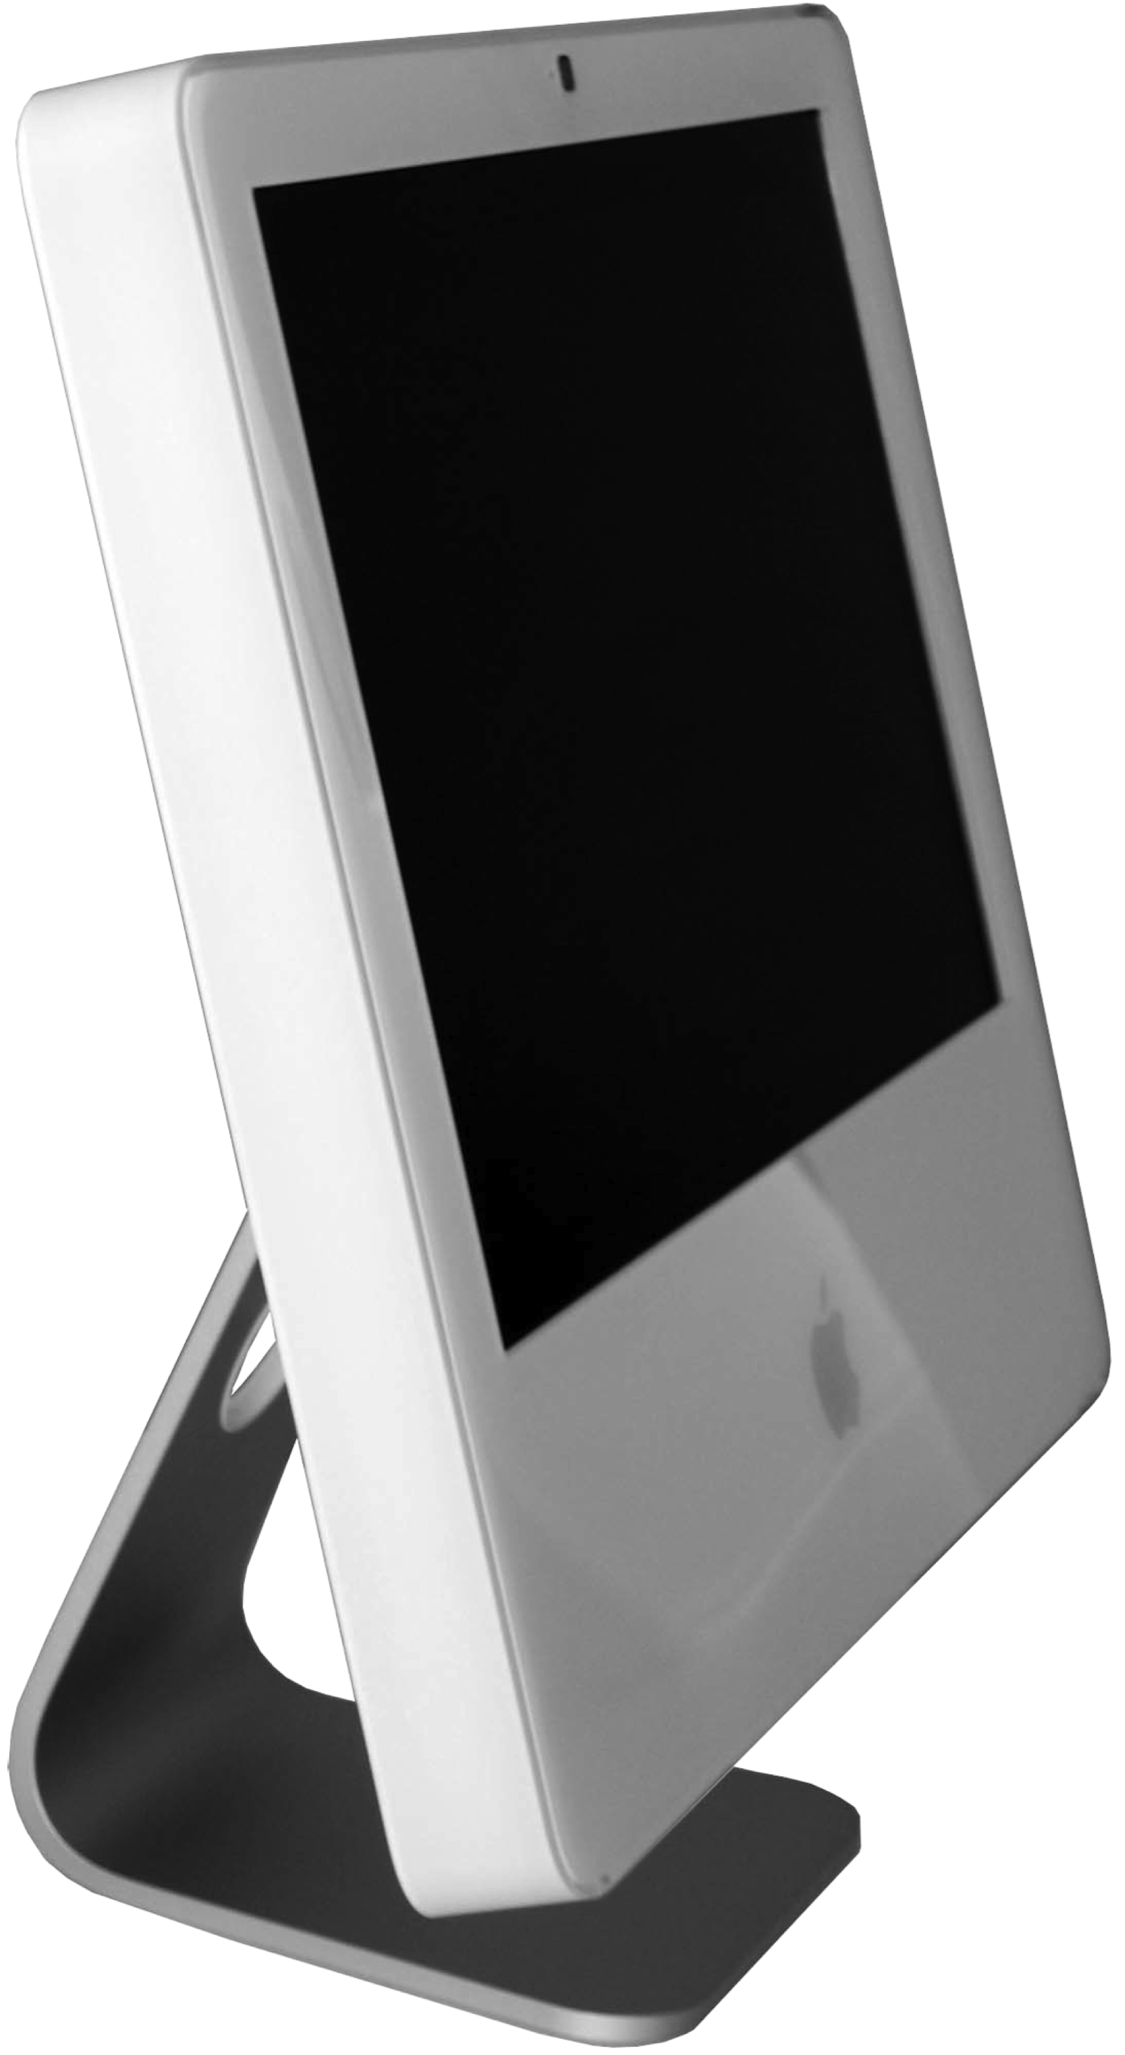
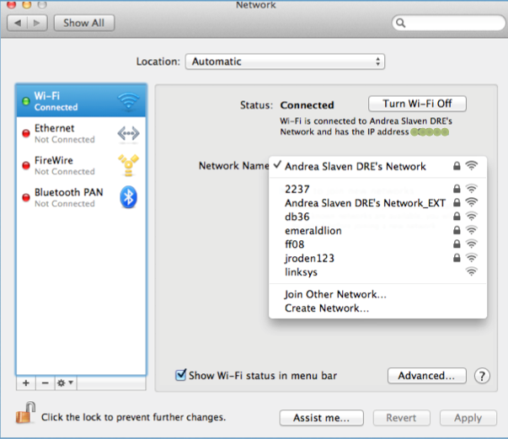
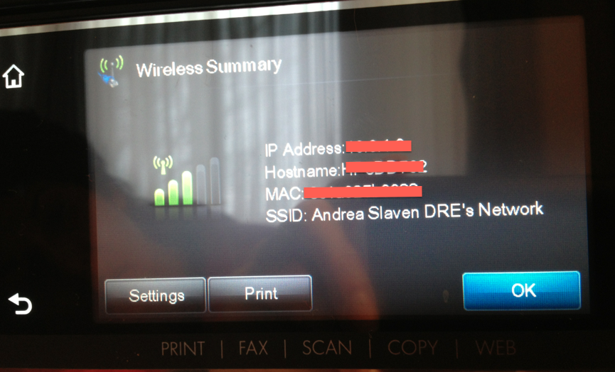
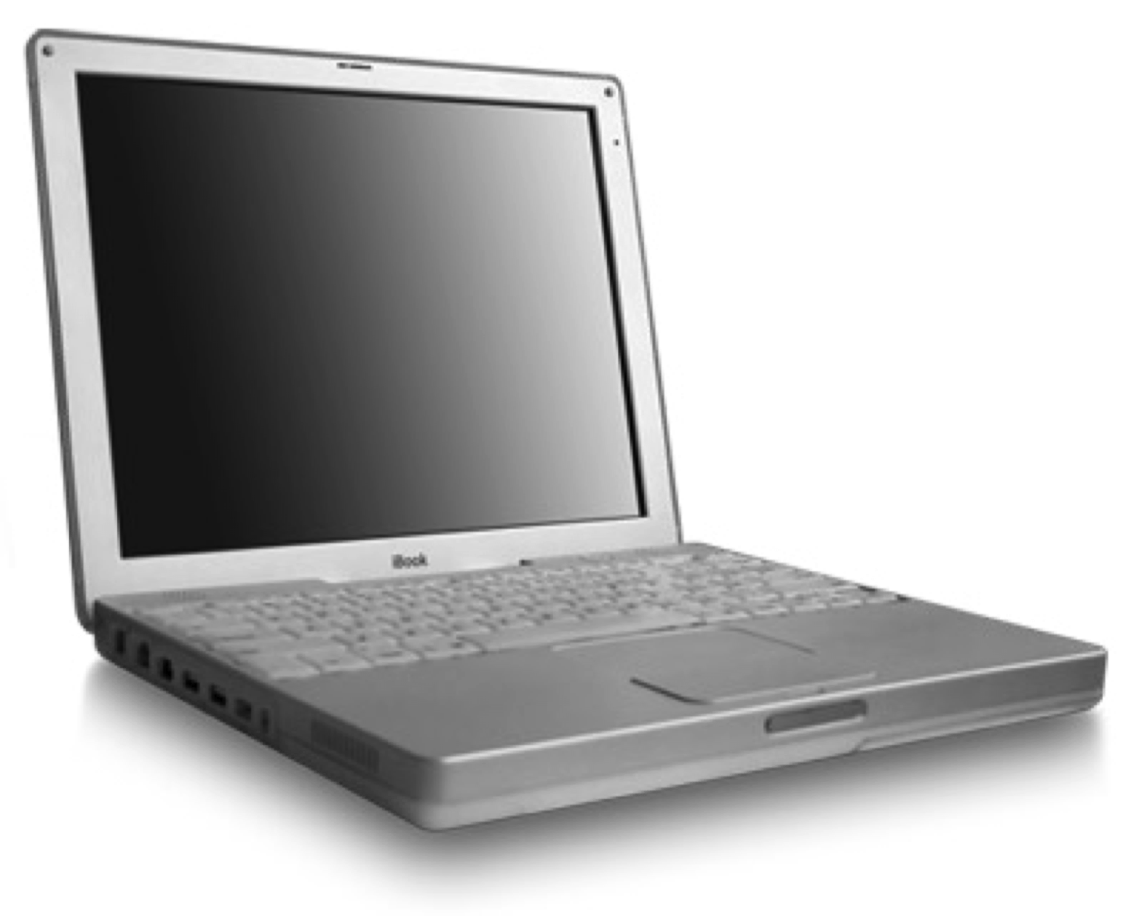
Network Settings
Make sure the printer and computer are on the same network.
Return to the home screen and choose the next option to check or choose other options for connections

Slide 7
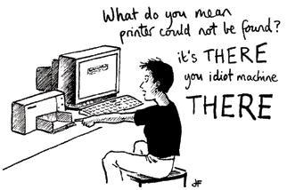
Check Drivers & Settings
I can’t find my printer!
Drivers | Preference Settings | Print Settings | Home

Slide 8
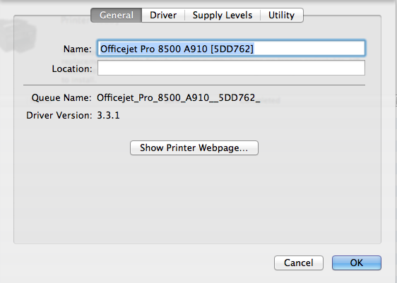
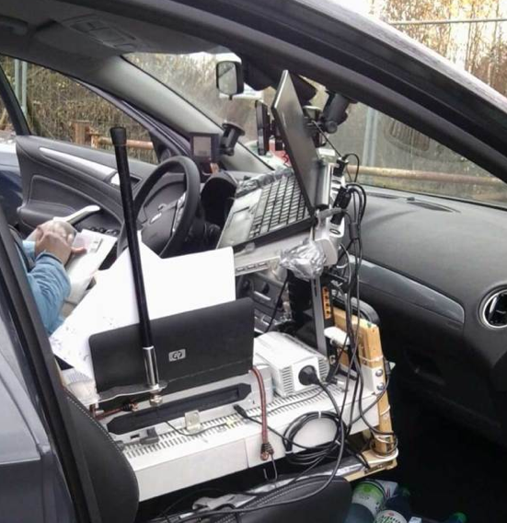
Correct Driver!
Drivers
Poor driver
decision!
Image "Cite"
Drivers can be found on the HP website:
http://h20000.www2.hp.com/bizsupport/TechSupport/ProductList.jsp?cc=us&taskId=135&prodSeriesId=4083864
Still not printing? Check Printer Preference Settings.

Slide 9
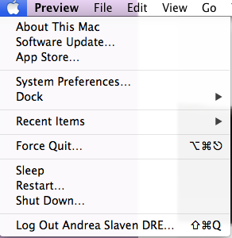
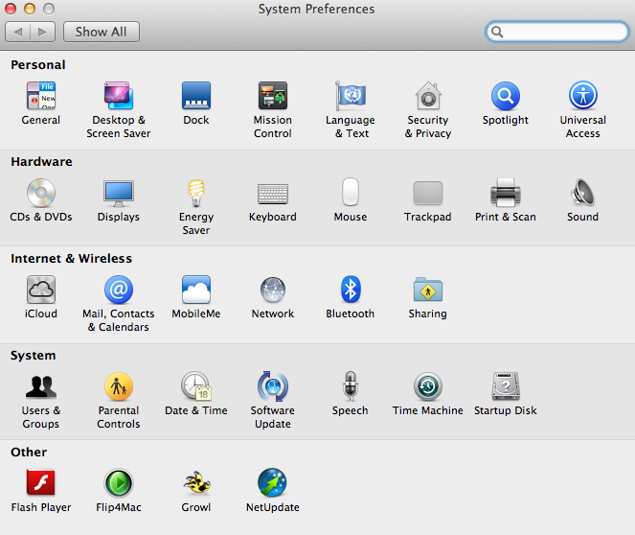
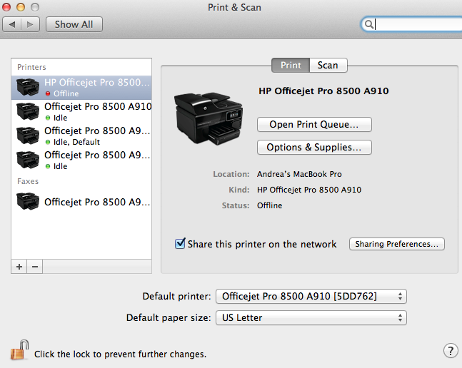
Preference Settings
Check to make sure your printer is listed and is connected. Notice here there is one printer that is offline and three connected, but idle.
1. Open the finder window and click System preferences
2. Click Print & Scan
3. Make sure the printer you are using is listed and online.
Still not printing? Check Printer Settings.

Slide 10
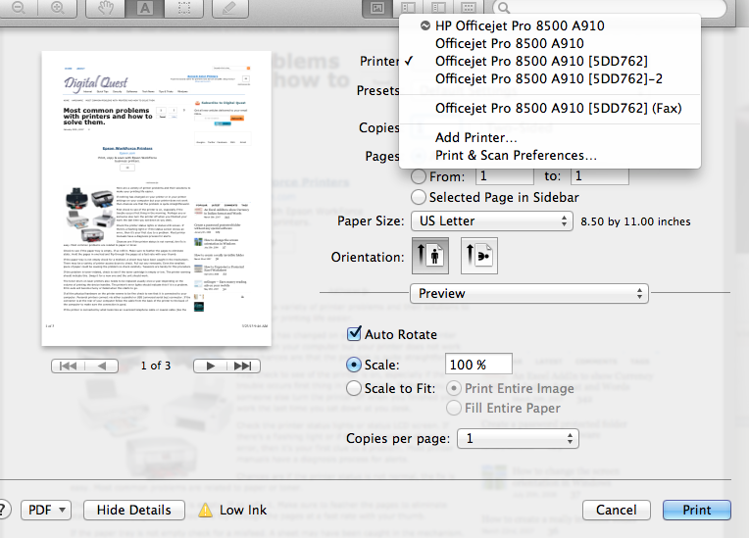
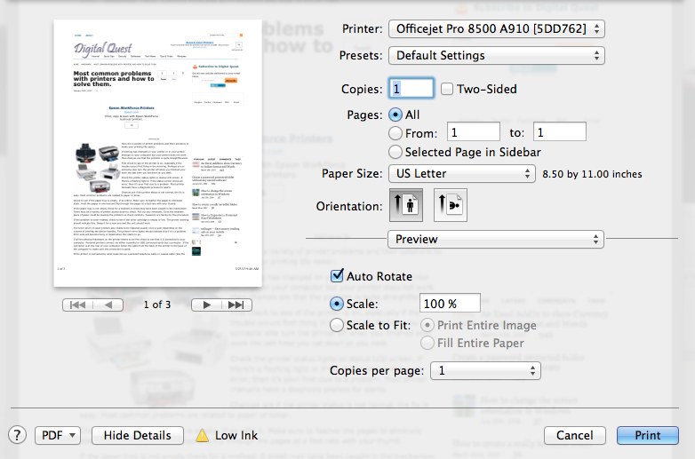
Print Settings
After choosing PRINT, your printer window pops up. In the printer window, make sure you have the correct printer chosen. If not, click the pop-down arrows to open the printer directory. Choose the correct printer.

Slide 11
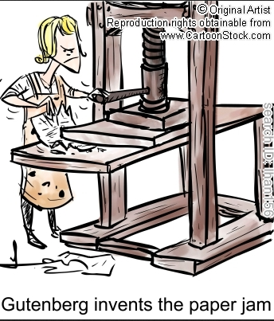
Check Paper Cartridges
http://www.cartoonstock.com/directory/p/printing_press.asp (Copyright would need purchased for publishing)
Jam Area Back Roller | Jam Area Top Load | Jam Area Front Load | Home

Slide 12
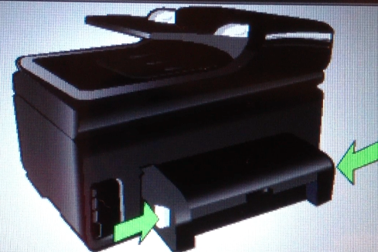
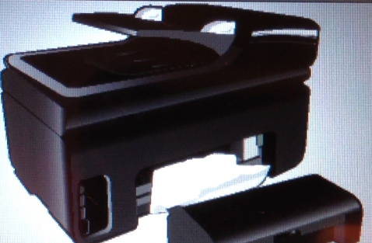
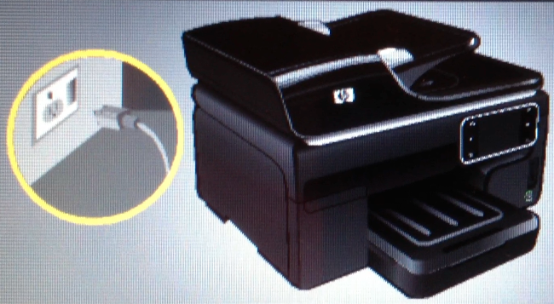
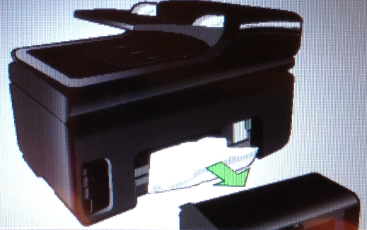
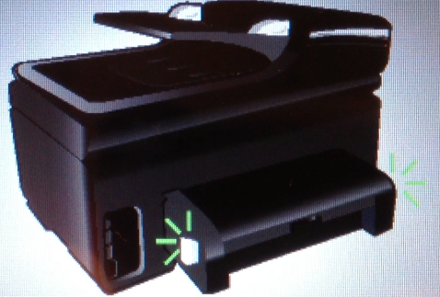
Clear Back Roller Jam
2. Look to back of printer. Push the two side release tabs to loosen the feed roller.
1. Turn Power off and unplug from power source.
3. Remove feed roller
6. Plug unit in and turn on power.
4. Remove paper.
5. Snap feed roller back on.
Still not printing? Check top or front load.

Slide 13
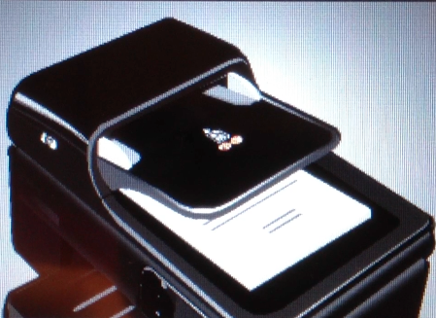
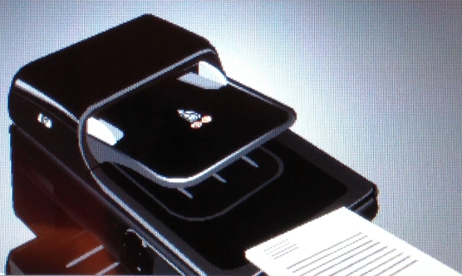
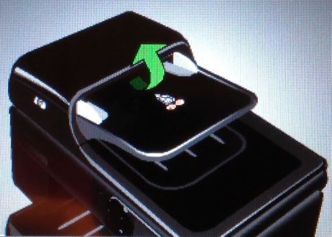
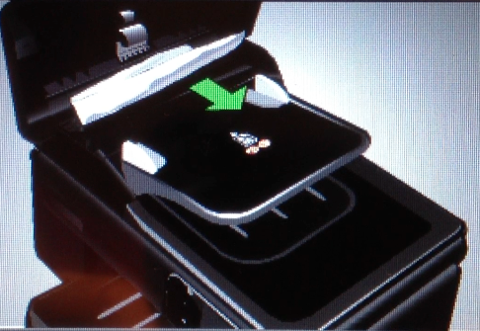
Clear Top Load Feed
2. Look to top feeder.
1. Turn Power off and unplug from power source.
3. Remove documents.
6. Close top. Plug unit in and turn on power.
4. Lift the top feeder.
5. Remove jammed paper.
Still not printing? Check front load.

Slide 14
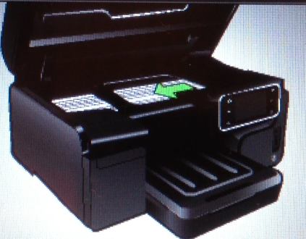
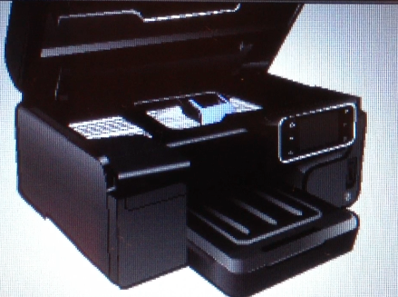
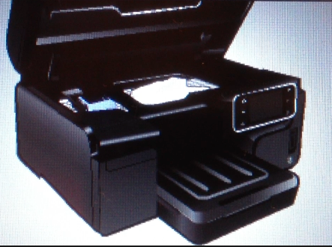
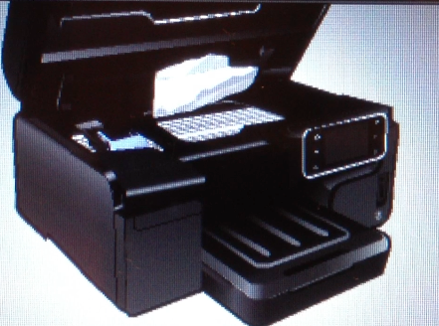
Clear Front Roller Jam
Print Settings
2. Look to back of printer. Push the two side release tabs to loosen the feed roller..
1. Turn Power off and unplug from power source.
3. Wait for printer head to finish moving to left side.
6. Plug unit in and turn on power.
5. Remove jammed paper.
4. Find jammed paper.
Still not printing? Check top or front load.

Slide 15
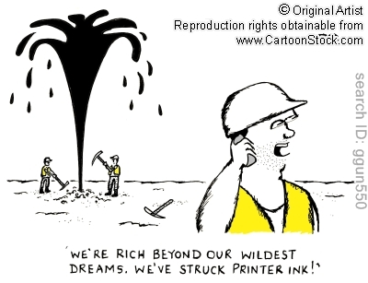
Check Ink Status
http://www.cartoonstock.com/newscartoons/cartoonists/ggu/lowres/ggun550l.jpg
(Copyright would need purchased for publishing)
Check Ink Status | Change Ink Cartridge | Home

Slide 16
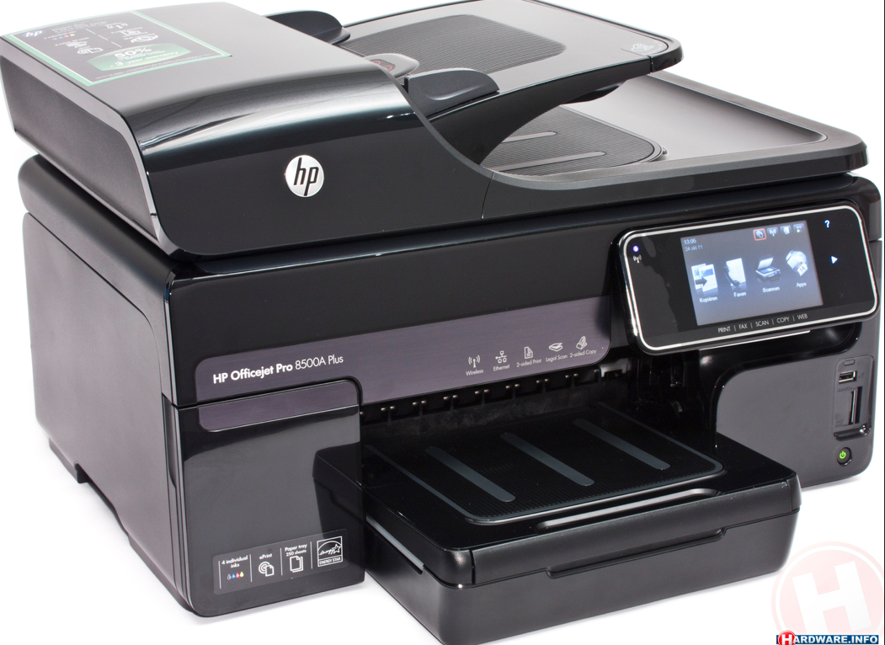
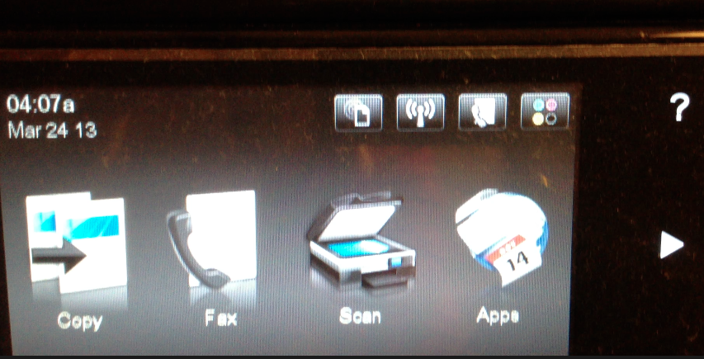
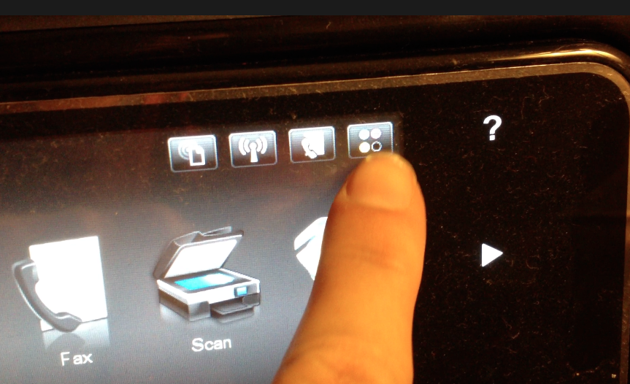
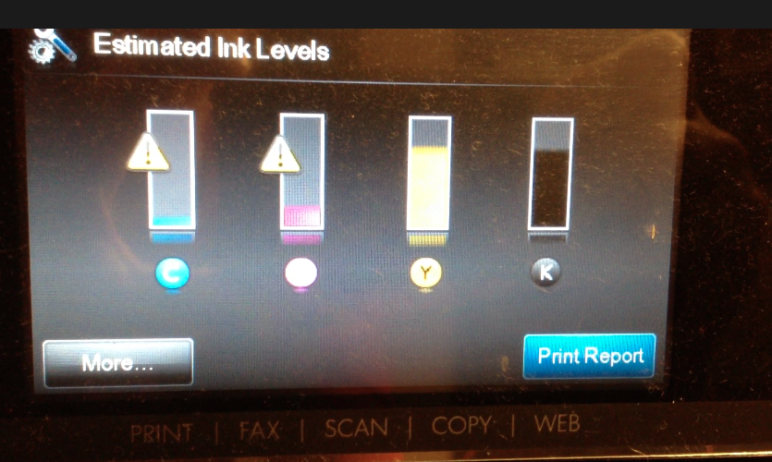
Check Ink Status

Slide 17
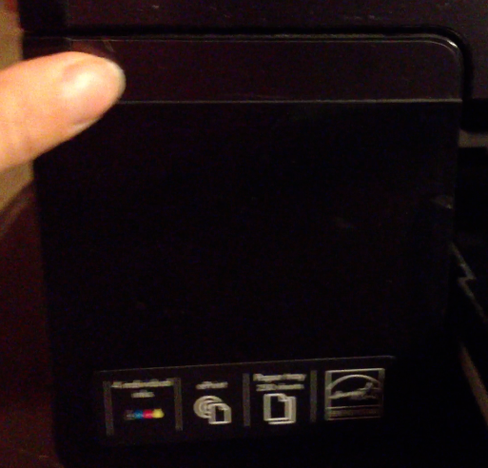
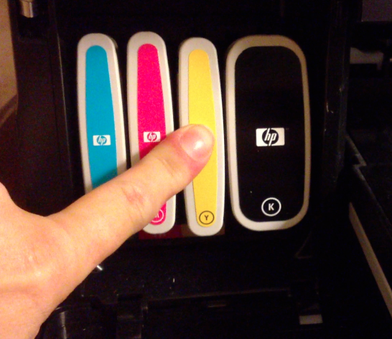
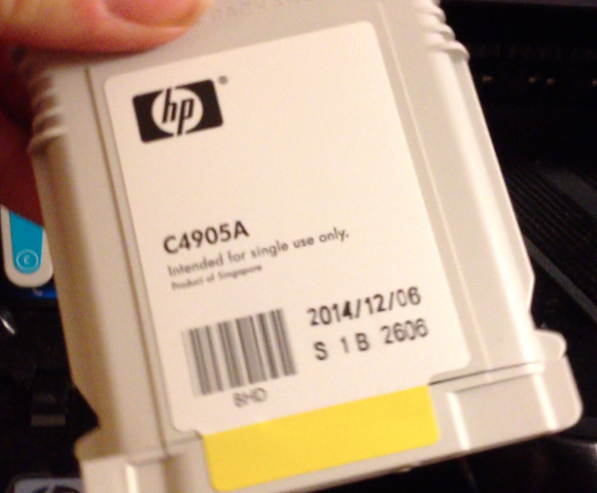
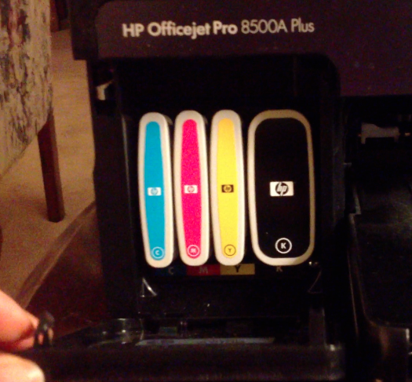
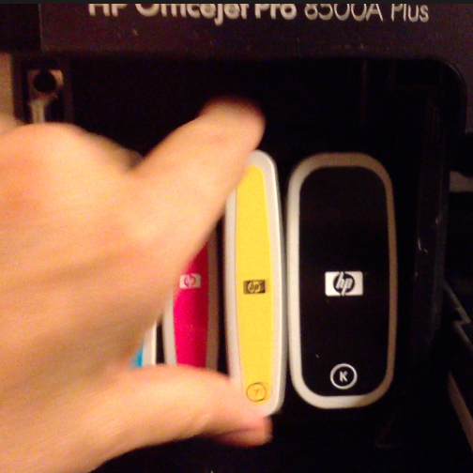
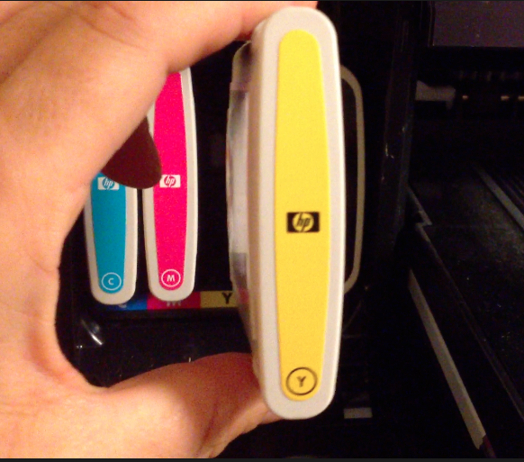
Change Ink Cartridge
5. Line ups notches in slots and push straight in until it clicks.
6. Close door.
4. New Ink
1. Open printer door
2. Pull cartridge straigh out
3. Remove

Slide 18
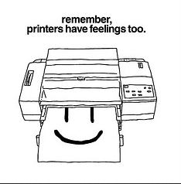
More Resources
http://flickrhivemind.net/Tags/happy,printer/Interesting
Maintenance Tips | HP Support | End

Slide 19
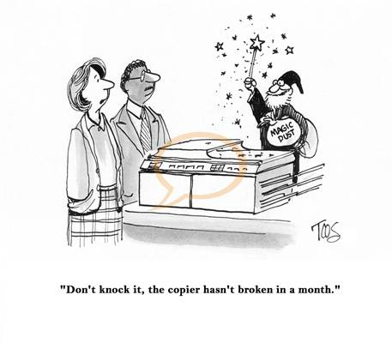
General Maintenance
http://www.cartoonresource.com/umbraco/ImageGen.ashx?image=/325728/cco103ts.jpg&class=full
Image has copyright to purchase.
Clean the scanner glass
To clean the scanner glass
1.Turn off the device.
2.Lift the scanner lid.
3.Clean the glass by using a soft, lint-free cloth that has been sprayed with a mild
glass cleaner. Dry the glass with a dry, soft, lint-free cloth

Slide 20
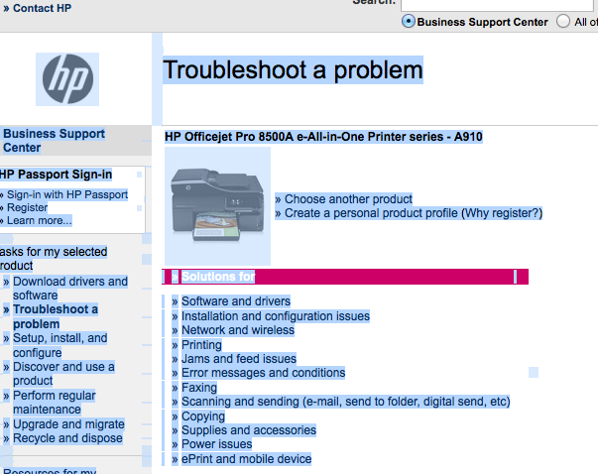
Support & Resources
HP 8500 User Guide
More HP Troubleshooting
Ink Supplies for 8500
Send your help request to:
aslaven@syrdio.org

Slide 21
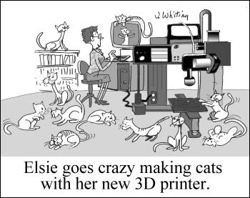
Have fun printing….
…but not too much fun!

