Slide 1
Inside a Clunker Computer
Andrea Slaven
TED 501 Spring 2013

Slide 2
Model:
Dell Optiplex 170L
Mini-Tower

Slide 3
Back of Unit

Slide 4
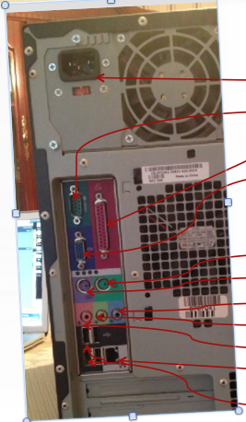
Back of Unit
Power supply
serial connector
parallel connector
video connector
mouse connector
keyboard connector
line-in connector
line-out connector
microphone connector
network adapter connector
USB 2.0 connectors (4)

Slide 5
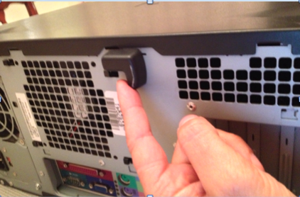
Opening the Case
A lever is on the back of the case. Push towards bottom to release.

Slide 6
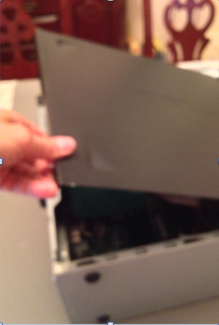
Lift the side and take the cover off.

Slide 7
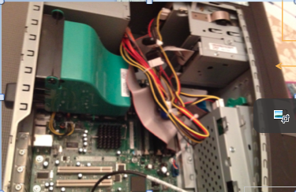
Insides of the Computer
power supply
CD drive
secondary CD bay
floppy drive
secondary hard drive bay
hard drive
Protective cover
over processor
system board

Slide 8
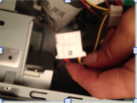
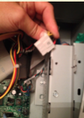
Unplug power
1
P-9 cord to the CD drive
2
P-3 cord to the hard drive

Slide 9
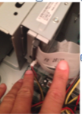
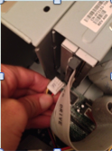
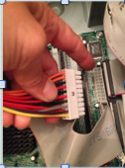
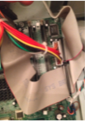
Unplug power
3
P-7 cord to the floppy drive
4
P-1 cord to the motherboard

Slide 10
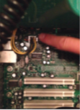
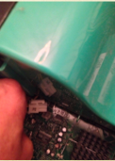
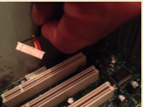
Unplug power
5
P-2 cord to the processor power connector (J5B1)
6
Front-panel audio connector

Slide 11
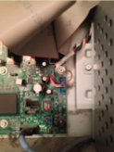
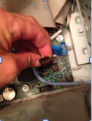
Unplug power
7
Front-panel connector (J9G1)
Front-panel USB connector (J9G1)
8

Slide 12
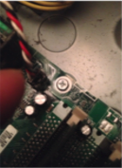
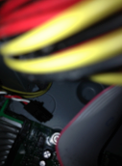
Unplug power
9
CPU Fan Connection

Slide 13
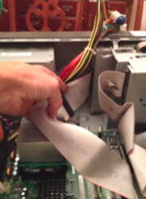
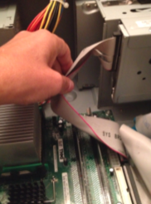
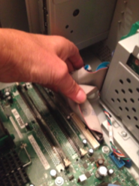
Unplug Data Cables
Cable to CD drive
Cable to Floppy drive
Cable to Hard Drive

Slide 14
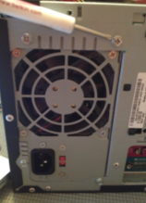
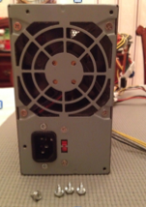
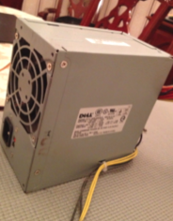
Remove Fan
Remove the four screws that secure the power supply to the back of the computer. wqê
Remove the power supply from the computer.

Slide 15
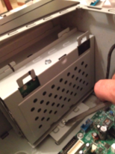
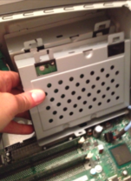
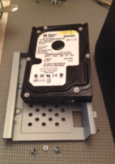
Remove Hard Drive
Remove the two bracket-securing screws, and
then remove the drive bracket from the computer.
Remove the hard drive-securing screw, and then remove the hard drive from the bracket.

Slide 16
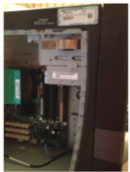
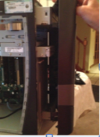
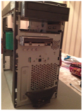
Front Panel Drives…
latches
In order to get to the CD Drive and the Floppy Drive, the front panel needs to be removed.
This was done by releasing the top latch, and a bottom latch found at the bottom of the inner wall.
Once the latches were released, the front panel was able to come off.
o

Slide 17
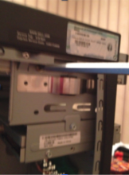
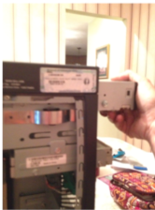
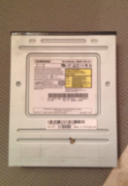
Removing CD Drive
Remove screw from bracket.
Slide CD drive out from front.

Slide 18
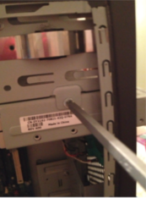
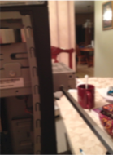
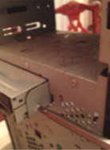
Removing Floppy Drive
Remove screws to release Floppy drive out from front.
Remove screw to release bracket from case.

Slide 19
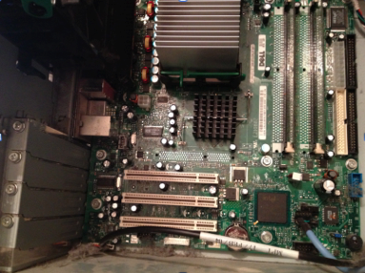
The Motherboard (Mobo)
Heat sink
CPU
DIMM Cards in slots
Power connector
floppy drive connector
hard-drive connector
CD/DVD drive
Chip Set
Expansion Slots
battery

Slide 20
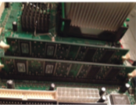
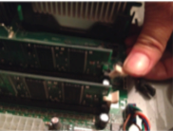
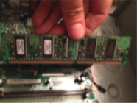
More Mobo
Removing a DIMM Card
DIMM Cards
Press down on levers to release DIMM card.
Lift DIMM card up.

Slide 21
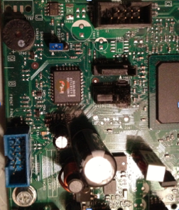
More Mobo
This CMOS uses jumper settings.

Slide 22
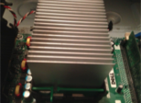
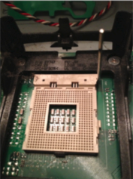
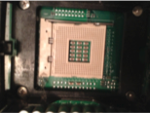
CPU, CPU, Where are you?
First I removed the green clips that locks the heat sink to the retention base. Next, to remove the heat sink, press the tabs on the retention base while lifting one end of the heat sink
The CPU socket is now
exposed…but where is
the CPU?
If there was a CPU, it would be sitting ontop of the socket. To remove it, lifting the lever releases it

Slide 23
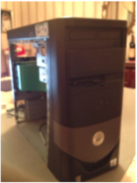
Putting it all back together!
This was just a matter of going backwards.
The CPU heat sink was locked into place.
Floppy Drive was replaced with 4 its screws.
The CD Drive was slid back into its housing and screwed in place.
The front of the case was replaced simply by lining it up, and pressed into place until it clicked.
Then the hard drive was replaced into its bracket, and place back with its screws.

Slide 24
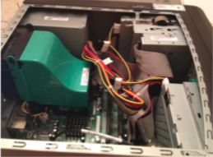
Putting it all back together!
Plugging in the cables and the power.
First, I reconnected the data cables: Hard drive, CD drive and Floppy Drive.
Next, returned the power supply by lining it back in place and securing it with 4 screws.
Next, power went to CPU Fan, the processor power, Mother Board, CD Drive, Floppy
Drive, Front panel and USB connections.
The cover was closed over the processor.

Slide 25
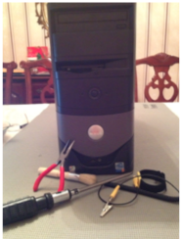
Done! That was Fun!
The side panel was then slid back in place.
This unit had simple hardware that used a Philip’s head screwdriver.
Also used was a needle nose, just to help when my fingers could not hold small screws.
The brush was used to remove dust.
Normally, an anti-static bracelet would be worn, but this unit has not had
power in it for a long time.

