Slide 1
Ink Blots
TED 501 Group Printer Project
Anthony Roberto
Andrea Slaven
Chelsea Hall
Jesse Santonastaso

Slide 2
Table of Contents
Building Demographics | Slide 3
Recommended Printers & Rationales | Slide 8
Purchase Plan & Yearly Estimates | Slide 22
Maintenance Plans | Slide 30
Environmental Considerations | Slide 66
References | Slide 67

Slide 3
Building Demographics
Demographic
Building Setup
# of computers per room
# of printers per room

Slide 4
Demographics
Demographics: New two story elementary school wing for 3rd -5th students. All rooms equipped with Dell Optiplex 745 P4 computers running XP Professional and Office 2002.
Grade | # Classes | # Students/Class | Total # Students/Grade
3rd | 5 | 22 | 110
4th | 5 | 22 | 110
5th | 5 | 22 | 110
 |  | Total Amount of Students | 330
Faculty | # Classes
Secretaries | 2
Teachers | 18
Librarian | 1
Librarian aide | 1
Principal | 1
ETS | 1
Total # of Faculty | 24

Slide 5
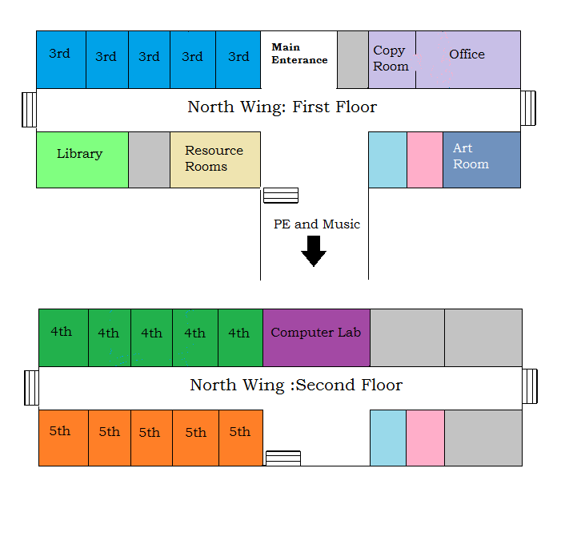
Building Setup

Slide 6
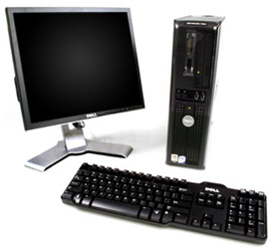
# of Computers per location
Office:
3 computers
Copy Room:
1 computer
Library:
8 computers
Computer Lab:
26 computers
Classrooms (including Art):
64 computers (4 per/classroom)
Physical Education
1 computer
Music
1 computer
Total # of Computers:
104 computers

Slide 7
# of Printers per location
Office:
1 basic printer
Copy Room:
1 Xerox copier/printers
Library:
1 multifunction printer
Computer Lab:
1 high speed printer
Classrooms:
15 basic printers (1 per classroom)
PE and Music share:
1 basic printer
Art Room:
1 color printer
Total # of Printers Needed:
17 basic printers
1 multifunction printers
1 high speed
1 Xerox copier/printers
1 color printer
Total: 21 printers

Slide 8
Recommended Printers & Rationales
Location | Printer Selected
Classrooms P.E./Music | HL-2275DW
Art | MFC-J4410DW
Library & Computer Lab | MFC-9560CDW
Office Copy Room | Xerox Work Centre 5150

Slide 9
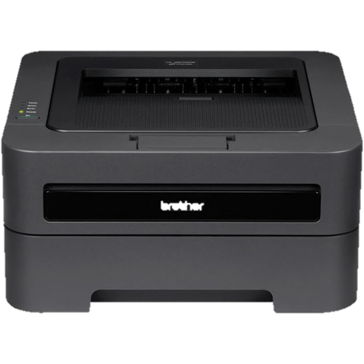
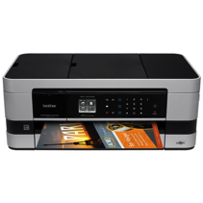
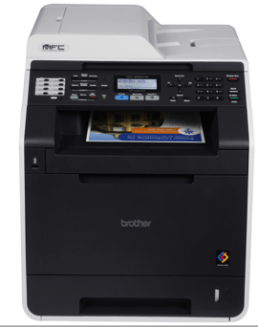
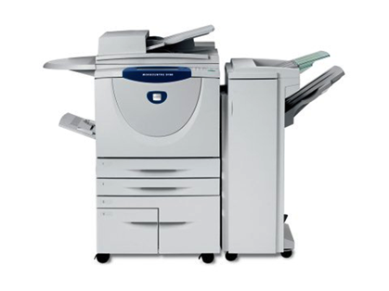
Printers Selected
HL-2275DW
MFC-J4410DW
Xerox WorkCentre 5150
MFC-9560CDW

Slide 10
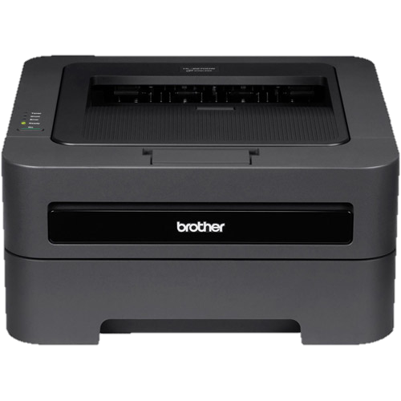
Classrooms, Office, & P.E./Music
Printer
Recommended Printer: HL-2275DW
Compact Laser Printer with Wireless Networking and Duplex

Slide 11
Rationale for Basic Printer in the Classroom
A compact laser jet has been chosen for Grades 3-5 because of its cost effectiveness and efficiency printing. Laser printers, in general, are more suited for high-volume and high-quality printing requirements. The findings for our classroom needs are based on the number of students in each classroom, printing needs for students, printer sharing capabilities, initial cost and annual costs.
Networking Needs: Each of the 15 elementary classrooms for grades 3-5 is equipped with 5 computers, one for the teacher and 4 for students. At most, only 4 students will be printing at any one time. The HL-2275DW allows you to share the printer with multiple users via an Ethernet and/or wireless 802.11b/g interface. 32 MB memory will handle documents from the 5 computers.
Print Technology: Most elementary classroom documents will only need black and white, therefore the classroom printer chosen is for black and white printing only. Projects needing to be printed in color can be printed in the school’s computer lab. The print speed for HL-2275DW is 27ppm, which will allow the teacher to print documents easily for the class in a matter of a minute. Students will also be able to print documents quickly. The print resolution will be crisp at 2400 x600 dpi.

Slide 12
Cost Effectiveness: HL-2275DW has duplex printing capability which allows printing on both sides of the sheet, saving paper usage. Toner is far more efficient than inkjet. The HL-2275DW also has a Toner-Save Mode as well as high yield toner replacement cartridge option which prints approximately 2,600 pages
System Requirements: HL-2275DW is compatible with the school’s computer OS, Windows XP Professional and will work for future Windows OS if computers are upgraded.
Usage: Recommended monthly print volume ranges from 250 pages to 2,000 pages for optimal quality. Maximum monthly duty cycle is 10,000 pages, far exceeding classroom needs.
1 year limited warranty: Go to Warranty Page
Includes in package:
(1) Standard Yield Toner Cartridge (yields approx. 1,200 pages‡) (1) DR420 Drum Unit (yields approx. 12,000 pages‡) CD-ROM – Includes User's Manual and Printer Drivers AC Power Cord Quick Setup Guide

Slide 13
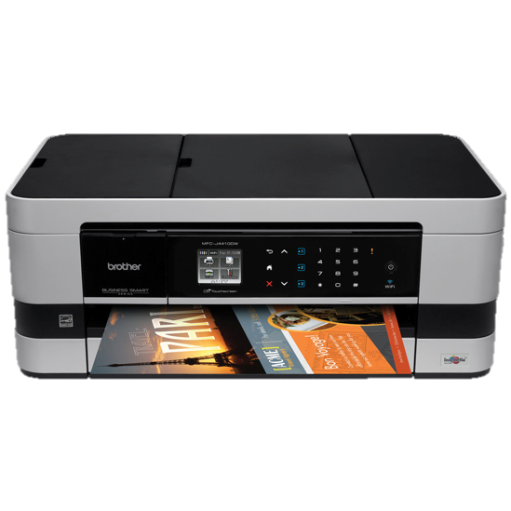
Art Room Printer
Recommended Printer: MFC-J4410DW
Business Smart™ Inkjet All-in-One Printer

Slide 14
Rationale for Inkjet in the Art Room
By using a colored inkjet printer for the art classroom, students will be able to bring their pictures and graphics to life with high quality color on photo paper. The MFC-J4410DW is both a small and inexpensive printer capable of producing multiple pages of color as well as basic text. The multi-cartridge layout provides a cheaper and more concentrated use of ink. The MFC-J4410DW comes equipped with both a media card slot and USB port which are perfect for creativity amongst the art students and teacher. Black and white and color copying and scanning can also be a great additive for distributing art work.
Networking Needs: Since there are 5 computers in the art room that can be networked, the MFC-J4410DW printer has wireless 802.11b/g/n capabilities. This inkjet also supports high-speed USB 2.0, Pictbridge, Ethernet, Media Card, and USB flash memory interfaces.
Print Technology: This inkjet has a better resolution than most at 6000 x 1200 dpi making it suitable for an art room. The printer will produce 33 ppm of black documents and 25 ppm of colored pictures; making it fully functional for a class of 18 students working on the art computers.
Cost Effectiveness: Although ink cartridges generally need to be replaced more often than toner cartridges, this printer has the ability to replace specific ink colors rather than combining pigments. This will ultimately save money on ink in the future.

Slide 15
Rationale for Inkjet in the Art Room Continued
System Requirements: The MFC-J4410DW inkjet will be compatible with the elementary school’s operating system because it works with Windows XP Home and Office, Windows Vista, and some versions of Mac OS X. If the school should decide to upgrade or even change computer brands, this inkjet should still be usable in the art classroom.
Usage: This printer has a recommended monthly print volume of 250-2,000 printed pages and 13,000 printed pages for a maximum monthly duty cycle. Considering the amount of printing to be done in the art classroom, these numbers are extremely generous.
Warranty- Comes with a 2-year limited warranty
Includes:
LC103BK, LC103C, LC103M, LC103Y Starter Ink Cartridges
(4) LC103 Series Starter Ink Cartridges
CD-ROM – Assembly for Windows and Mac
User's Manual
Quick Setup Guide
Telephone Line Cord

Slide 16
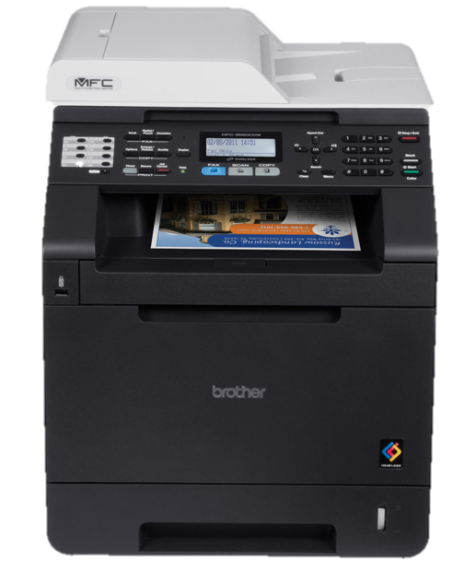
Library & Computer Lab
Recommended Printer: MFC-9560CDW
Multi-function Color Laser Wireless Networking and Duplex

Slide 17
Rationale for Library & Computer Lab Continued
Multi-function color laser printers has been chosen for the Library and Computer Lab. These areas would need the color laser technology for reports and projects. The Library in particular would need scanning and copying capabilities, and therefore, the multifunction seemed the most cost effective. The MFC-9560CDW Digital Color All-in-One with Wireless Networking and Duplex is selected as it is ideal for small businesses and workgroups. It offers wireless, Ethernet and USB interfaces. This model does include fax which does not need to be set up, however, the Librarian may need this feature for purchase orders, sending materials to other schools, etc.
Networking Need: The computers with wireless networking. The MFC-9560CDW has options for 802.11b/g Wireless, Ethernet and high speed USB 2.0.
Print Technology: Uses color laser technology producing vibrant color documents at 600x2400 dpi resolution. Students can be proud of their work when produced with quality color printing. High speed printing allows 25 colored and black and white prints per minute.
Memory: Memory will be more of a factor in the Library and Computer Labs with more computer users networked onto the printer. The library has 8 computers and needs sufficient memory. The MFC-9325CW includes 256MB standard on the unit, however it has the option to increase memory up to 512 MB, which may be needed in the computer lab.

Slide 18
Rationale for Library & Computer Lab Continued
Cost Effectiveness: MFC-9560CDW has duplex printing capability which allows printing on both sides of the sheet, saving paper usage. Toner is far more efficient than inkjet. The MFC-9560CDW also has a Toner-Save Mode as well as high yield toner replacement cartridges for each of the four toner colors (black, yellow, cyan, and magenta).
System Requirements: MFC-9560CDW is compatible with the school’s computer OS, Windows XP Professional and will work for future Windows OS if computers are upgraded.
Usage: Recommended monthly print volume ranges from 500 pages to 3,000 pages for optimal quality. Maximum monthly duty cycle is 40,000 printing pages.
1 year limited warranty: Go to Warranty Page
Includes in package:
(1) TN310BK Standard Yield Black Toner Cartridge (2,500 pages)
(1 each) TN310C/TN310M/TN310Y (1,500 pgs each)
(1) DR310CL Drum Unit (25,000 pgs) CD-ROM – Includes User's Manual and Printer Drivers AC Power Cord Quick Setup Guide

Slide 19
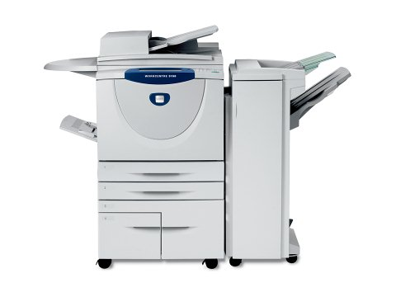
Copy Room Printer
Recommended Printer:
Xerox WorkCentre 5150

Slide 20
Rationale for Copy Room Printer
The Xerox WorkCentre 5150 printer is the ultimate system for a teacher’s copy room. This copier/printer handles complex jobs and is extremely versatile. Aside from basic copying and printing options, this printer comes equipped with a stapler, a hole punch, and other document folding techniques making it perfect for student worksheets and lesson plans. The Xerox 5150 can handle multiple jobs simultaneously and has the capacity to work at a high speed for all 24 faculty members.
Networking Needs: Since all of the computers can be networked in the elementary school, it is possible to print directly to this printer. It has the options of a hookup using a 10/100Base-TX Ethernet cable, Wireless Ethernet, and even USB print. Holding up to 512 MB of memory, it is appropriate for a hefty printing and copying queue.
Print Technology: This Xerox has a print resolution of 1200 x 1200 dpi and a copy resolution of up to 600 x 600 dpi. With an initial print output of 3.4 sec, this WorkCentre prints up to 55 ppm and has four different trays of paper or envelopes to choose from. This system saves a lot of time for teachers when printing multiple copies for their students. Having it hole punch and staple is an added bonus in time management.
Cost effectiveness: Since this is a laser printer, the toner cartridge is initially expensive but is not replaced as often. Like other printers we have chosen, this printer also offers duplex printing to save on paper. It meets the latest ENERGY STAR requirements and reduces energy by combining the functions of multiple products in one.

Slide 21
Rationale for Copy Room Printer Continued
System Requirements: The WorkCentre 5150 works with all current operating systems in schools and office industries. This includes: Windows Server 2003, Windows XP, Windows Server 2008, Windows Vista, and Mac OS.
Usage: This printer and copier has a maximum duty cycle of up to 200,000 pages per month. This is sufficient enough for an elementary wing of teachers to print out worksheets or lesson plans for their students.
Warranty: Xerox will refund or fix this product within 90 days of the purchase and additional support is pending.
Includes:
Toner cartridges (capacity: 64,000 pages each)
Power cord
Software and documentation

Slide 22
Purchase Plan & Yearly Estimates
Initial Purchase
Consumables: Paper
Consumables: Brother HL-2275DW (basic)
Consumables: Brother MFC-J4410DW (inkjet)
Consumables: Brother MFC-9560CDW (multifunction)
Consumables: Xerox Work Centre 5150 (copy room)

Slide 23
Purchase Plan / Initial Set up
Room | Brand | Model | Price | Quantity | Total Cost
Classrooms | Brother | HL-2275DW | $149.99 | X 17 | $2550
Art Room | Brother | MFC-J4410DW | $179.99 | X 1 | $180
Library/Computer Lab | Brother | MFC-9560CDW | $649.99 | X 2 | $1300
Copy room (Office) | Xerox | Xerox WorkCentre 5150 | $13,399 | X 1 | $13,400
 |  |  |  | Total | $17,430
First Year Consumables (including paper) |  | Refer to Purchase Plan/Consumables |  | Total | $18,685
 |  |  |  | Approx. TOTAL | $36,000
Most prices based from “BrotherMall” quotes

Slide 24
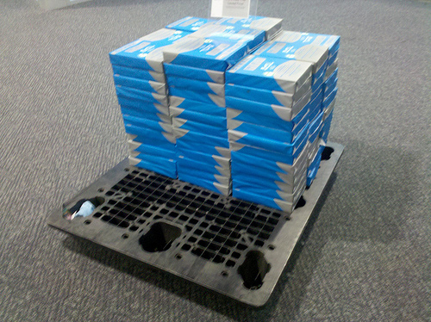
Consumables
One extra box of most consumables will be maintained in the copy room off the office.
When ever a consumable is used a replacement will be ordered.

Slide 25
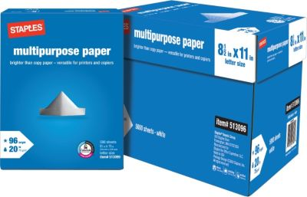
Paper/year
Paper | Item # | Description | Price | Amount | Total Cost
 | 513096 (Staples) | Cartons of Paper, 20lb, multipurpose (5,000 sheets) | $49.99 -25.00 rebate= 24.99 | x160 (800,000 prints) | $4,000

Slide 26
Purchase Plan: Consumables/year
Item # | Description | Price | Amount | Total Cost
TN450 | High Yield toner (2,600 pages/classroom) | $47.32 | x 17 (1 replacement for each printer) | $804.44
DR420 | Drum Unit (12,000 pages) | $104.99 | x 3 (spares) | $314.97
Total: |  |  |  | $1,120

Slide 27
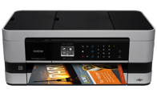
Purchase Plan: Consumables/year Continued
Item # | Description | Price | Amount | Total Cost
LC107BK | Innobella™ Super High Yield (XXL Series) Black Ink Cartridge (Yields approx. 1,200 page) | $29.99 | X1 (spare) | $29.99
LC1053PKS | 3-Pack of Innobella™ Super High Yield (XXL Series) Color Ink Cartridges (1 each of Cyan, Magenta, Yellow) (Yields approx. 1,200 pages) | $63.49 | X1 (spare) | $63.49
Total: |  |  |  | $95

Slide 28
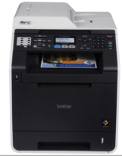
Purchase Plan: Consumables/year Continued
Item # | Description | Price | Amount | Total Cost
TN315C | High Yield Cyan Toner Cartridge (yields approx. 3,500 pages) | $124.99 | x 10 (106 prints per student) | $1249.99
TN315M | High Yield Magenta Toner Cartridge (yields approx. 3,500 pages) | $124.99 | x 10 | $1249.99
TN315Y | High Yield Yellow Toner Cartridge (yields approx. 3,500 pages) | $124.99 | x 10 | $1249.99
TN315BK | High Yield Black Toner Cartridge (yields approx. 6,000 pages) | $116.99 | x 5 | $584.95
DR310CL | Drum Unit (yields approx. 25,000 pages) | $179.99 | x 4 | $719.96
WT300CL | Waste Toner Box (50,000 page yield) | $26.49 | x 2 | $52.98
BU300CL | Belt Unit (approx. 50,000 page) | $136.49 | x 2 | $272.98
Total: |  |  |  | $6,500

Slide 29
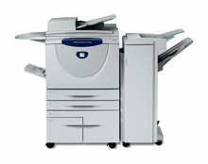
Purchase Plan: Consumables/year Continued
Continued
Printer | Item # | Description | Price | Amount | Total Cost
WorkCentre 5150 | 006R01046 | Xerox Black Toner (64,000 pages) | $279.00 | x10 (640,000 pages) | $2790.00
5150 | 108R00493 | Xerox Staple Cartridge | $119.00 | x1 (spare- order as needed) | $119.00
5150 | 008R12941 | Xerox Staple Refills (5000 staples) | $116.00 | x40 (200,000 staples) | $4640
Total: |  |  |  |  | $7,550

Slide 30
Maintenance Plans
Brother HL-2275DW (basic)
Brother MFC-J4410DW (inkjet)
Brother MFC-9560CDW (multifunction)
Xerox Work Centre 5150 (copy room)

Slide 31
Maintenance Plan Brother HL-2275DW
17 units

Slide 32
Cleaning Maintenance
Item | Frequency
Outside | Monthly
Corona Wire | Bi-Monthly
Drum Cleaning | As needed (Yearly)
Paper Pick-up Roller | As Needed (Yearly)

Slide 33
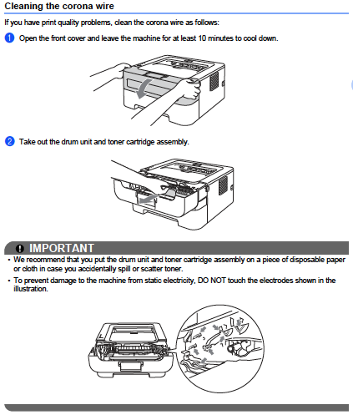
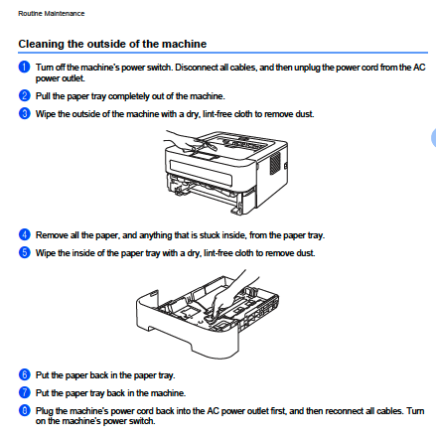
Outside Cleaning Schedule Once per Month by ETS or Classroom Teacher

Slide 34
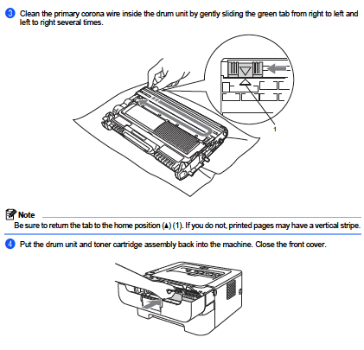
Cleaning Corona Wire

Slide 35
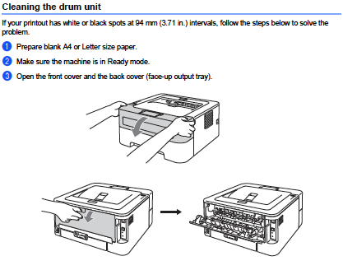
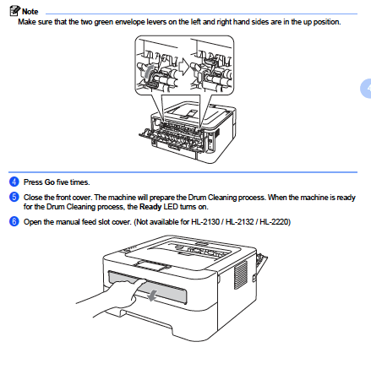
Drum Cleaning

Slide 36
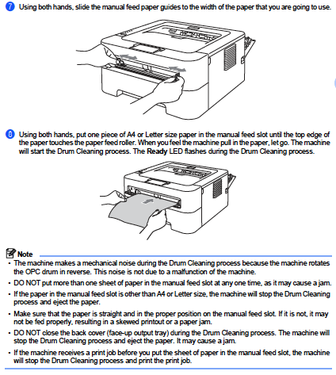
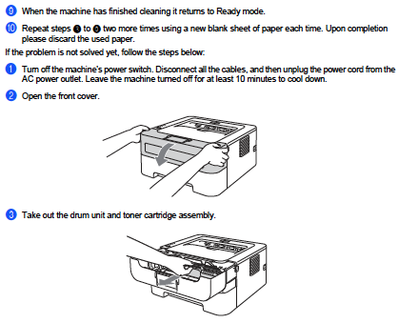
Drum Cleaning – Cont.

Slide 37
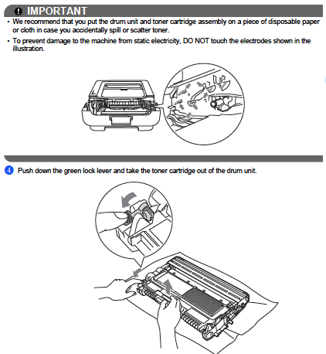
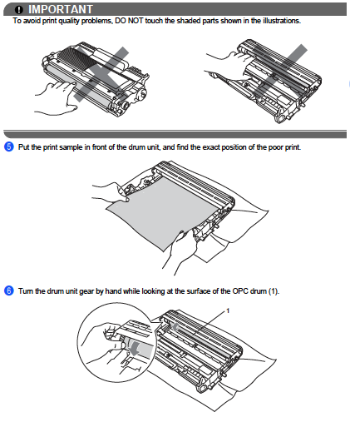
Drum – Cont.

Slide 38
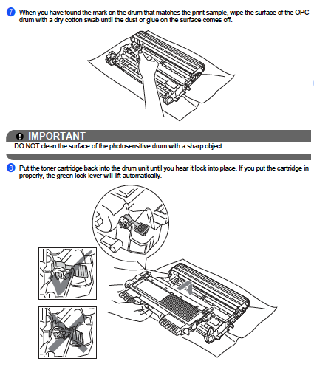
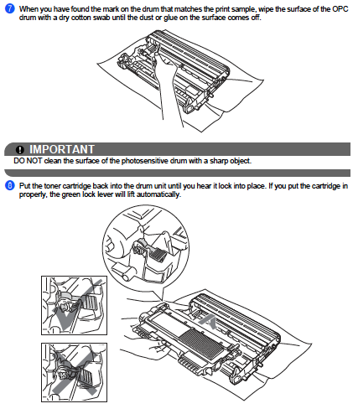
Drum – Cont.

Slide 39
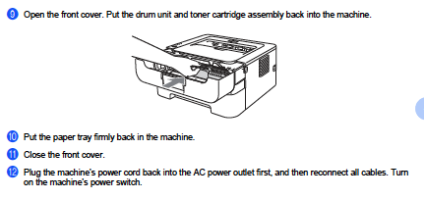
Drum – Finished

Slide 40
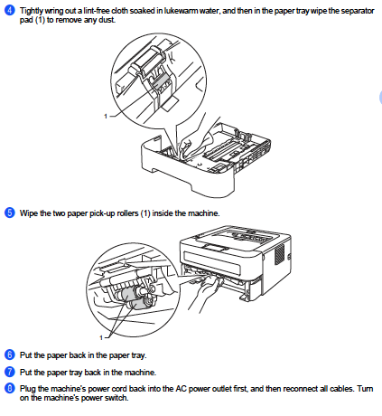
Cleaning Paper Pickup Roller

Slide 41
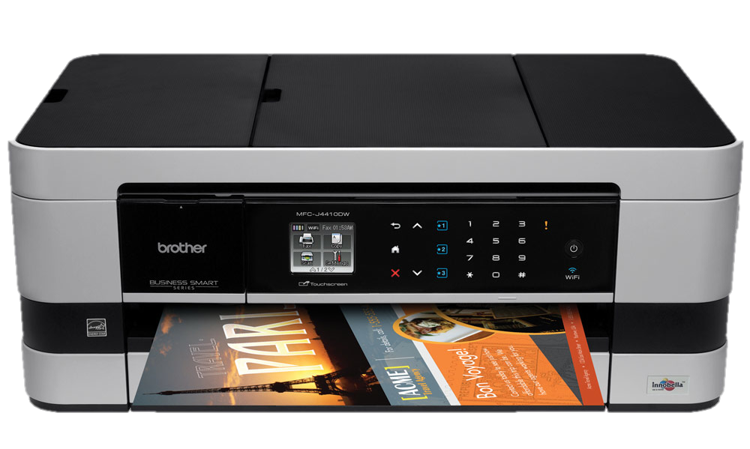
Maintenance Plan Brother MFC-J4410DW
1 unit

Slide 42
Cleaning Maintenance
Item | Frequency
Cleaning & Checking the Printer | Monthly
Cleaning the Printers Platen | Monthly
Cleaning the Paper Feed Rollers | Monthly
Drum Cleaner | As Needed (Yearly)
Paper Pick-up Roller | As needed (Yearly)

Slide 43
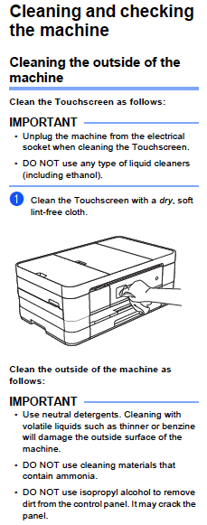
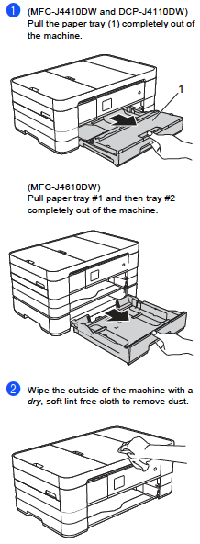
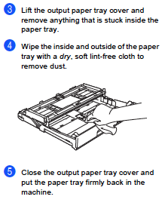
Cleaning and Checking the Printer

Slide 44
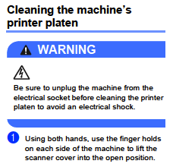
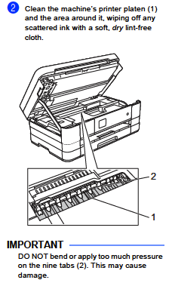
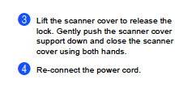
Cleaning the Printers Platen

Slide 45
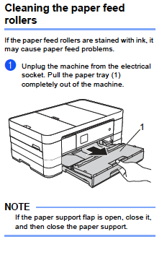
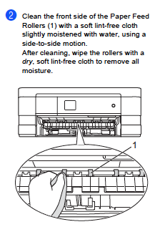
Cleaning the Paper Feed Rollers

Slide 46
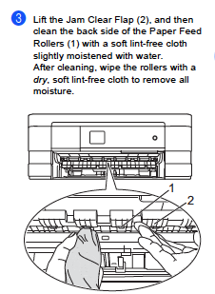
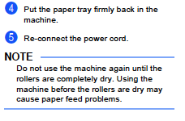
Cleaning the Paper Feed Rollers - Continued

Slide 47
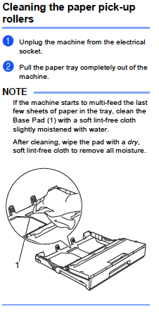
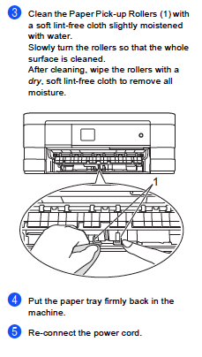
Cleaning the Paper Pick-up Rollers

Slide 48
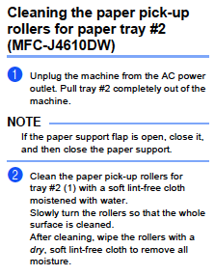
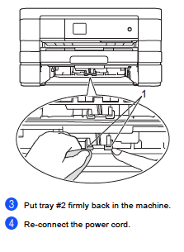
Cleaning the Paper Pick-up Rollers: Tray #2

Slide 49
Maintenance Plan MFC-9560CDW
2 units

Slide 50
Cleaning /Maintenance Plan
Item | Frequency
Outside | Monthly
Laser Scanner Window | Bi-Monthly
Corona Wires | As needed (Yearly)
Drum Cleaner | As Needed (Yearly)
Paper Pick-up Roller | As needed (Yearly)

Slide 51
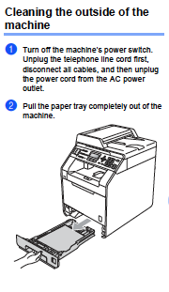
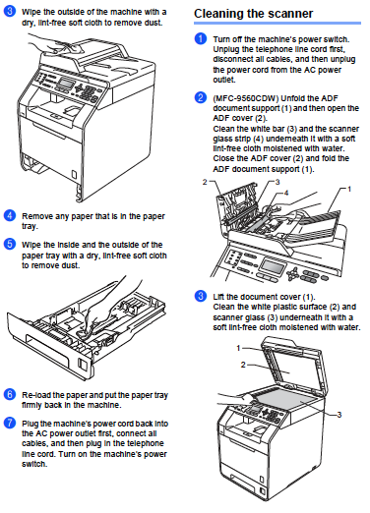
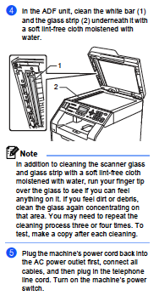
Outside Cleaning

Slide 52
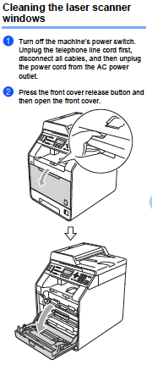
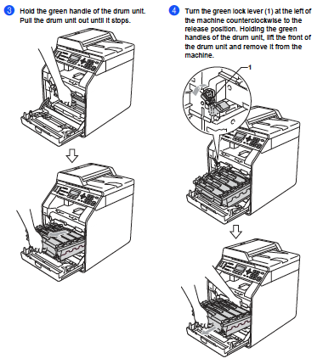
Cleaning Laser Scanner Window

Slide 53
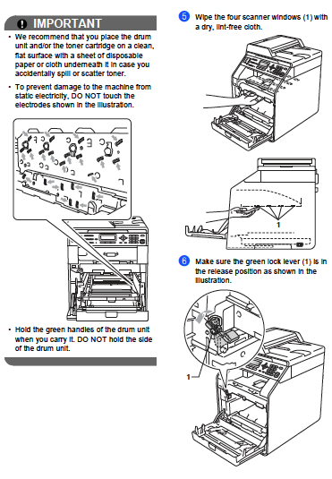
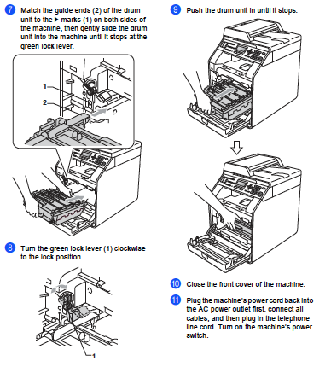
Cleaning Laser Scanner Window – Cont.

Slide 54
Corona Wires

Slide 55
Corona Wires – Cont.

Slide 56
Drum Cleaning

Slide 57
Drum Cleaning – Cont.

Slide 58
Drum Cleaning – Cont.

Slide 59
Cleaning Paper Pick-up Rollers

Slide 60
Maintenance Plan Xerox 5150
1 units

Slide 61
Toner Cartridges
A typical toner cartridge will provide 64,000 pages.
This is just an estimate and depends on conditions such as content, paper size, paper type and the computer environment.
Toner should never be thrown out as the remaining toner can cause an explosion.
The old toner cartridge should be returned in the box the replacement toner came in. Xerox toner boxes come with return labels for old containers.

Slide 62
Replacing Consumables
A message will appear on the display screen and will walk you through the replacement of consumables.

Slide 63
Machine Cleaning
The machine will issue the following message “the Scanner may be dirty. See user guide or label instructions on the document feeder to wipe the scanning glass.”

Slide 64
Machine Cleaning
Once a month clean the document feeder rollers. This should be done with a damp cloth. Take note not to use organic solvents.

Slide 65
Other Problems
Other parts may break or need occasional replacement.
To handle these types of maintenance items as well as regular cleaning a contract with Hudson Valley Office Equipment will be used. The price based on the number of pages our price is based on usage of .0171 cents per page. This includes providing all consumables for the printers.

Slide 66
Environmental Considerations
Energy Star Compliant
All products incorporate the following:
Conserving energy through power management
Sleep mode
Running cooler and lasting longer
On average, 25% more efficient
Product Take Back/ Recycling
Brother International Corporation has engaged Sims Recycling Solutions to perform recycling services in the State of New York. For more information and drop off site(s) please click here. Or call 1-888-699-6632.
Toner Cartridge Disposal
Brother offers free shipping labels to ship used toner cartridges for disposal. Click here.
http://www.ogs.state.ny.us/purchase/snt/awardnotes/7552522418can.HTM

Slide 67
References
Brother Advanced User Manuals:
HL-2275DW
MFC-J4410DW
MFC-9560CDW
Xerox WorkCentre 5150
Copier/Printer System Administration Guide
BrotherMall.com

