Slide 1
A seventeen year old boy with a dream…
Notes:
http://www.youtube.com/watch?v=4HWxhs9f6oc&feature=player_embedded#!

Slide 2
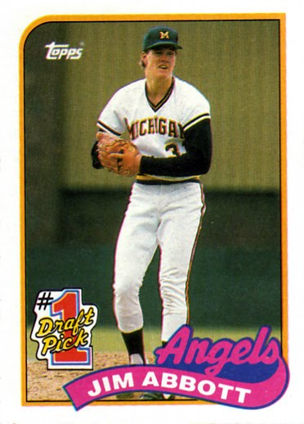
…to be a baseball player
Notes:
http://mlbmemories.com/wp-content/uploads/2011/10/1989+Topps+F.jpg

Slide 3
How did his dreams
surface to the top
of the
iceberg?

Slide 4
Jim Abbott built his dream on the foundation of five qualities which he
acted from…

Slide 5
A
A
djust
D
D
etermination
A
A
ccountability
P
P
erserverance
T
rust
T
Notes:
Jim Abbott built his dream upon these actions. Adjust, determination, accountability, perserverance and trust. He used these qualities to adapt and achieve to be the accomplished baseball player we know today.

Slide 6
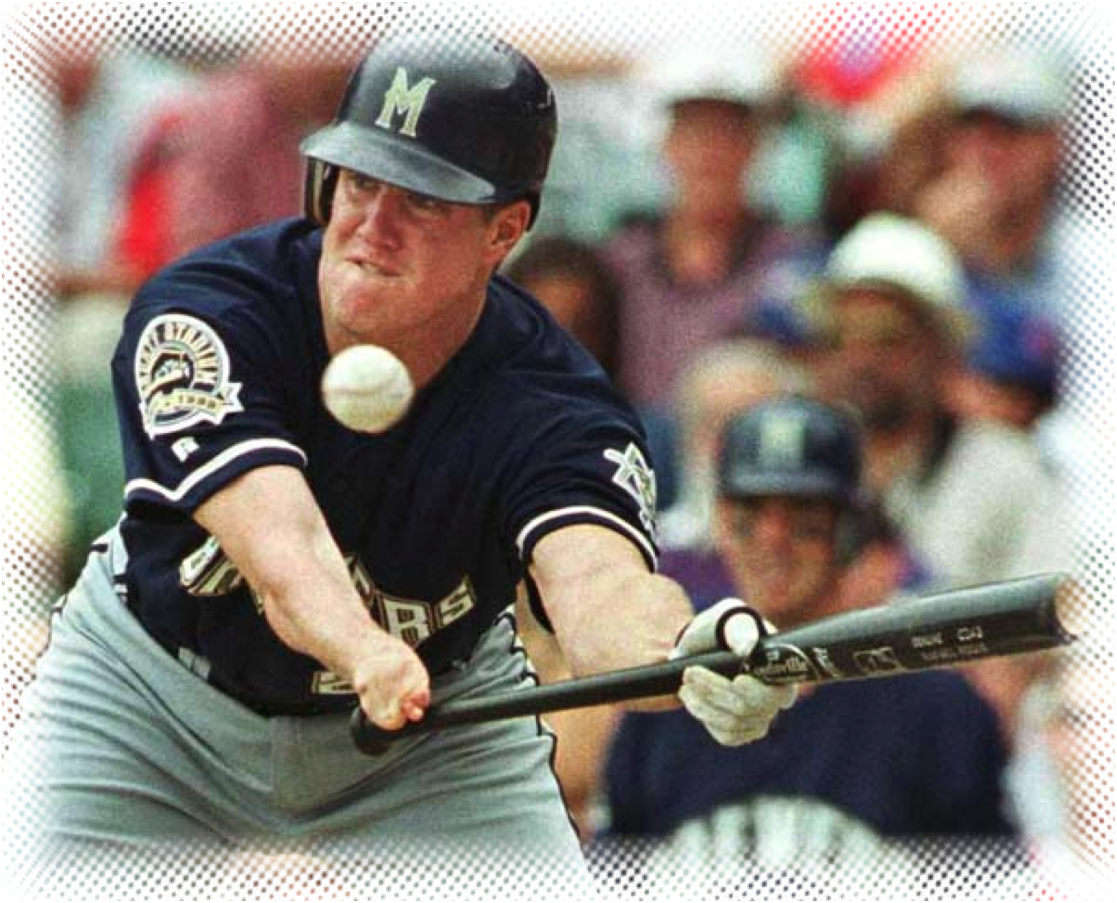
Adjust
Adjust to being different.
Do things in new ways…it takes risk.
“What’s taken away once, is given back twice.”
Notes:
As a child, Jim wanted to be like others. He wanted to join his friends, do what they did, but it meant doing things slightly different. It meant working with others to help in the adjustments also. In one of his talks, Jim Abbott discusses how he was “recruited” to play football in his junior year. He and the team had to make a few adjustments, such as snapping the ball. In baseball, Jim learned to adjust what others took for granted, like holding a baseball bat. In order to achieve his dream, Jim made those adjustments, and worked on them.
http://www.jimabbott.net/speaking.html?submenuheader=1

Slide 7
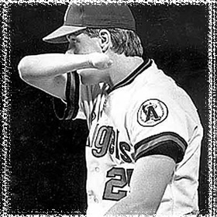
Determination
Be true to yourself.
Not be swayed.
The only limits are only ones you put on yourself.
Notes:
Many times there are forces or influences that try to sway you with negativity. People will test your true grit. Jim speaks of a story that his first college win came when the other team tried to steal home on the catcher’s throw back to him. The opposing team underestimated the determination of Jim and tried to fluster him to no avail. Jim saw no limits. The only limits are the ones you put on yourself when you listen to the negative forces.
http://www.jimabbott.net/speaking.html?submenuheader=1
http://www.youtube.com/watch?v=-C4TE97XeU4

Slide 8
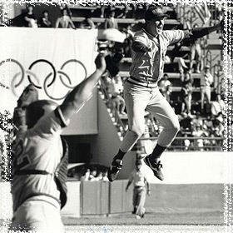
Accountability
Be Accountable to others…
Always bring the best of
Yourself.
“You can either be a fountain,
or a drain for others.”
Be Accountable to yourself…
You have an obligation to make the most of your abilities.
Always try - take risks.
“Get in the game!”
Notes:
Be accountable to others, whether it is teammates, family, co-workers. Always bring the best of yourself to the table. Be accountable to yourself to use your gifts and talents to the best of your abilities. Jim suggests to take the “mirror” test. Look in the mirror and ask yourself, “Am I being the best….(father?, worker? Teacher? Wife? Etc…)”
http://www.jimabbott.net/speaking.html?submenuheader=1
http://www.youtube.com/watch?v=_k32Sd-4HMQ

Slide 9
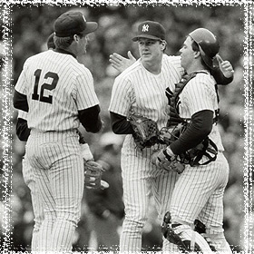
Perserverance
Stick to it!
Respond to adversity with positive actions.
“There is no finish line.”
Notes:
Jim talks about a very down time in his career. Sent back to the minor leagues was crushing. He could have called it quits. But instead, it was a lot of practice and pushing yourself. There is no finish line….ever. There is always a way, a purpose, a dream.
http://www.jimabbott.net/speaking.html?submenuheader=1

Slide 10
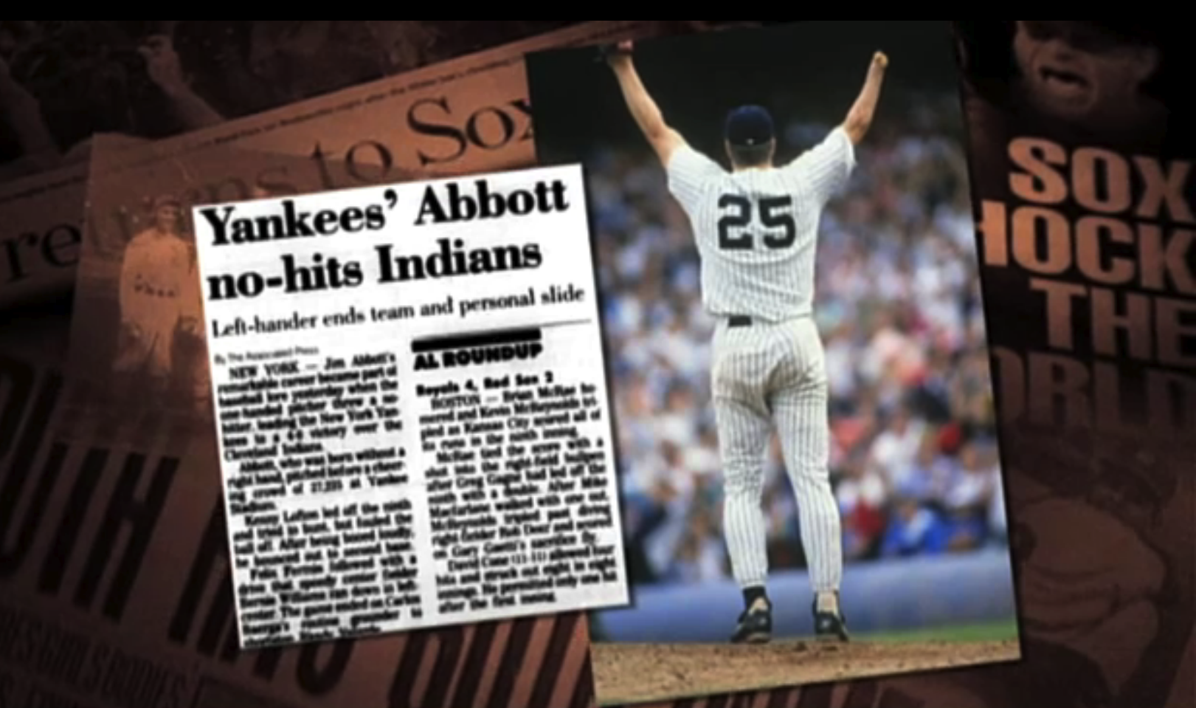
Trust
Trust in yourself and the work
you have done.. you're ready for this,
bring it on!
"This is who I am.”
Notes:
Jim speaks of the no hitter pitched Spetember 4, 1993. When you trust yourself, you can focus on what you can do…and do it well. As the game went on, inning after inning, with no hits, the excitement in the crowd and on the field intensified. Pressure was mounting, no pun here! Staying focused on the target meant trusting who you are.
http://www.youtube.com/watch?v=4HWxhs9f6oc&feature=player_embedded#!

Slide 11
Jim Abbott
1985
Pitched 4 no hitters in his senor year of high school
1987
Golden Spikes Award
And
Michigan's Most Valuable Pitcher.
1988
As a member of the U.S. Olympic baseball team, pitched an entire game for gold medal
2008-present
Jim is PITCH spokesperson for the US Department of Labor on hiring those with disabilites
1993
Pitched a no-hitter
first American pitcher to defeat Cuba in Cuba in 25 years.
A
D
A
P
T

Slide 12
Dream it –Live it.
Notes:
Reflection Question

Slide 13
How have you
been able to
A D A P T
to reach the
top?

Slide 14
Have any of your dreams become reality?
What actions do you need to take to
reach your dreams?
What are your dreams?
Notes:
Reflection Question

Slide 15
Andrea
As a student I become a better
Teacher
Lifelong learning has made me a student once again!
My creativity was used to create a new religious education program as director.
Parenting has given me patience..
My teaching years ended, but gave way to volunteering at church, I adapted!
“Work and then play” words of wisdom from my parents.
University of Pittsburgh showed me great diversity of thought and culture…
My years of dancing and teaching dance gave me poise, courage, and energy….
My dream was to be a teacher…

Slide 16
Websites used:
http://www.jimabbott.net/
http://www.youtube.com/watch?v=-C4TE97XeU4
http://mlb.mlb.com/video/play.jsp?content_id=11836755
http://www.youtube.com/watch?v=_k32Sd-4HMQ
http://www.youtube.com/watch?v=vQgMeKLK0t0&feature=related
http://sabr.org/bioproj/person/635e3a93

